Slide 1
EXAMPLE USING JDBC
(JAVA DATABASE CONNECTIVITY)

Slide 2
WHAT IS JDBC?
Java Database connectivity
Provides driver and API classes to communicate with the database
Functionalities of JDBC
Connect to a database
Retrieve the records to the front end application (using a query)
Perform data manipulations (INSERT, UPDATE & DELETE)
Execute a procedure & functions stored in the database
Packages used.
java.sql.*
javax.sql.*

Slide 3
CRUD operations on Employee(EmpId, EName, DOB, salary, phone)

Slide 4
Create table:
create table Employee(empid number(20) primary key, ename varchar2(20),
dob DATE,
salary number(20),
phone varchar2(20));

Slide 5
Application :
package jdbcapp.com;
import java.sql.Connection;
import java.sql.Date;
import java.sql.DriverManager;
import java.sql.ResultSet;
import java.sql.SQLException;

Slide 6
(continued..)
public class Employee {
public static void main(String[] args) {
// TODO Auto-generated method stub
String uid="dbuser";
String pwd = "1234";
String url = "jdbc:oracle:thin:@localhost:1521/XE";
Connection con;
try {
//load class dynamically
Class.forName("oracle.jdbc.driver.OracleDriver");
//create a connection object and connect to database
con = DriverManager.getConnection(url, uid, pwd);
System.out.println("Connected");
ResultSet rs ;
Statement stmt=con.createStatement();

Slide 7
(continued..)
try {
//insert employee record into database
String qry="INSERT INTO Employee VALUES(1,‘prasuna',TO_DATE('25/07/1999','dd/mm/yyyy'),250000,'1234567890')";
int i2=stmt.executeUpdate(qry);
if(i2>0) {
System.out.println("After Insertion");
rs = stmt.executeQuery("Select * from employee");
System.out.println("read employee records from database");

Slide 8
(continued..)
while(rs.next()){
System.out.println("Emp Id : " + rs.getInt("empid") + ", Name : " + rs.getString("ename") + ", Date of Birth : " + rs.getDate("dob")+" salary : "+rs.getInt("salary")+" phone no : "+rs.getString("phone"));
}
}else {
System.out.println("Insertion Failed");
}
}catch(SQLException e) {
System.out.println("unique key value vialotation " + e.getMessage());
}catch(IllegalArgumentException e) {
System.out.println("Invalid date format "+e.getMessage());
}

Slide 9
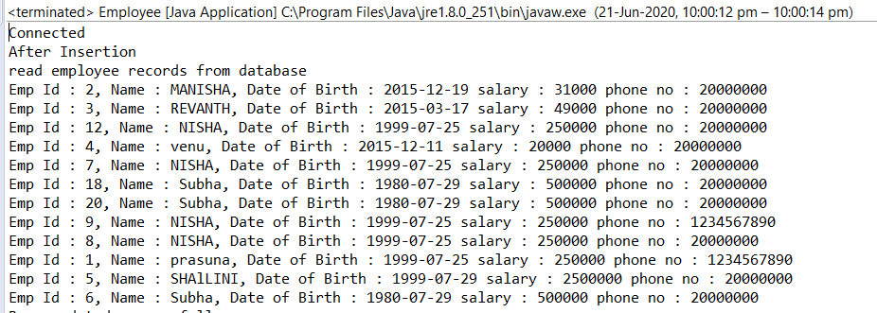
Output of insertion:

Slide 10
Update value :
//update employee record into database
String qry5= "Update employee set salary=31000 where empid=2";
int i1= stmt.executeUpdate(qry5);
if(i1>0) {
System.out.println("Rows updated successfully");
System.out.println("After Update");
//read employee records from database
rs = stmt.executeQuery("Select * from employee");
System.out.println("read employee records from database");
while(rs.next()){
System.out.println("Emp Id : " + rs.getInt("empid") + ", Name : " + rs.getString("ename") + ", Date of Birth : " + rs.getDate("dob")+" salary : "+rs.getInt("salary")+" phone no : "+rs.getString("phone"));
}
}else {
System.out.println("Row is Not Updated Succesfully");
}

Slide 11
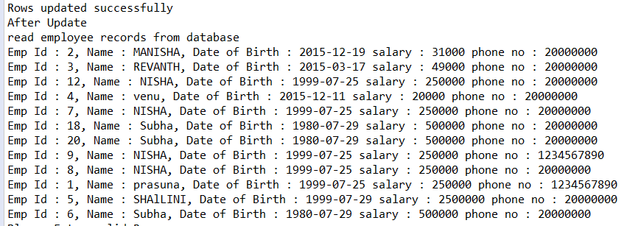
Output:

Slide 12
Delete from database :
//delete employee record from database
String qry6 = "delete from Employee where empid =18";
int i=stmt.executeUpdate(qry6);
System.out.println(i);
if(i>0) {
System.out.println("Row deleted succesfully");
System.out.println("After Deletion" );
rs = stmt.executeQuery("Select * from employee");
System.out.println("read employee records from database");
while(rs.next()){
System.out.println("Emp Id : " + rs.getInt("empid") + ", Name : " + rs.getString("ename") + ", Date of Birth : " + rs.getDate("dob")+" salary : "+rs.getInt("salary")+" phone no : "+rs.getString("phone"));
}
}else {
System.out.println("Please Enter valid Row");
}

Slide 13
(continued..)
con.close();
System.out.println("Disconnected");
}
catch(java.lang.ClassNotFoundException e) {
System.out.println("Oracle Driver not found");
}
catch(SQLException ex) {
System.out.println("SQLException:" + ex.getMessage());
}
}
}

Slide 14
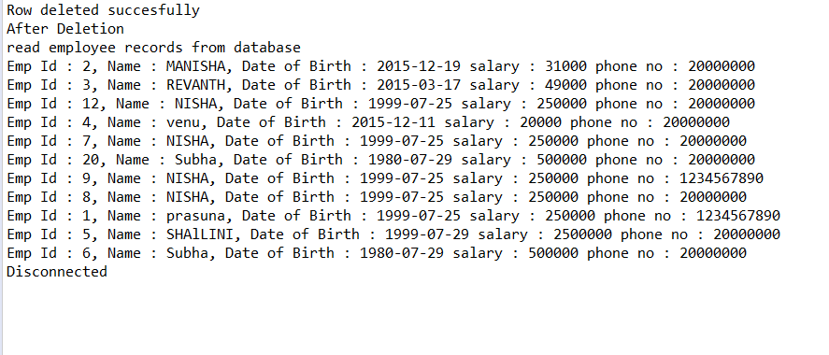
output

Slide 15
Modify the previous program , so that it uses stored procedure stored procedure for insert , update, delete operations .use callable statements to invoke the stored procedure.

Slide 16
stored procedural statement for insert employee
CREATE OR REPLACE PROCEDURE insertMyEmployee(EMPID IN NUMBER,
ENAME IN VARCHAR2,
EDOB IN DATE,
ESALARY IN NUMBER,
EPHONE IN VARCHAR2)
IS
BEGIN
INSERT INTO Employee VALUES(EMPID,ENAME,EDOB,ESALARY,EPHONE);
END;

Slide 17
stored procedural statement for UPDATE employee
create or replace procedure updateMyEmployee(EMPID IN NUMBER,
EPHONE IN VARCHAR2)
IS
BEGIN
update Employee set phone=EPHONE where empid=EMPID;
END;

Slide 18
stored procedural statement for DELETE employee
create or replace procedure deleteMyEmployee(EMPID IN NUMBER)
IS
BEGIN
delete from Employee where empid=EMPID;
END;

Slide 19
Application :
package jdbcapp.com;
import java.sql.CallableStatement;
import java.sql.Connection;
import java.sql.Date;
import java.sql.DriverManager;
import java.sql.ResultSet;
import java.sql.SQLException;
public class Employee1 {
public static void main(String[] args) {
// TODO Auto-generated method stub
String uid="dbuser";
String pwd = "1234";
String url = "jdbc:oracle:thin:@localhost:1521/XE";
Connection con;
CallableStatement stmt;
ResultSet rs;

Slide 20
try {
Class.forName("oracle.jdbc.driver.OracleDriver");
con = DriverManager.getConnection(url, uid, pwd);
System.out.println("Connected");
//insert employee record into database
String qry = "{call insertMyEmployee(?,?,?,?,?)}";
stmt=con.prepareCall(qry);
try {
stmt.setInt(1,18);
stmt.setString(2,"Subha");
stmt.setDate(3, Date.valueOf("1980-07-29"));
stmt.setInt(4,500000);
stmt.setString(5, "1234567890");
stmt.execute();
}catch(SQLException e) {
System.out.println("unique key value vialotation " + e.getMessage());
}catch(IllegalArgumentException e) {
System.out.println("Invalid date format "+e.getMessage());
}

Slide 21
//update employee record into database
String qry1="{call updateMyEmployee(?,?)}";
CallableStatement stmt1=con.prepareCall(qry1);
stmt1.setInt(1, 9);
stmt1.setInt(2,20000000);
stmt1.execute();
System.out.println("update employee record succesfully into database ");
String qry2= "{call deleteMyEmployee(?)}";
CallableStatement stmt2=con.prepareCall(qry2);
stmt2.setInt(1, 9);
System.out.println("delete employee record successfully from datebase");

Slide 22
//read employee records from database
rs = stmt.executeQuery("Select * from employee where empid=3");
System.out.println("read employee records from database");
if(rs.next()){
System.out.println("Emp Id : " + rs.getInt("empid") + ", Name : " + rs.getString("ename") + ", Date of Birth : " + rs.getDate("dob")+" salary : "+rs.getInt("salary")+" phone no : "+rs.getString("phone"));
}
con.close();
System.out.println("Disconnected");
}
catch(java.lang.ClassNotFoundException e) {
System.out.println("Oracle Driver not found");
}
catch(SQLException ex) {
System.out.println("SQLException:" + ex.getMessage());
}
}
}

Slide 23
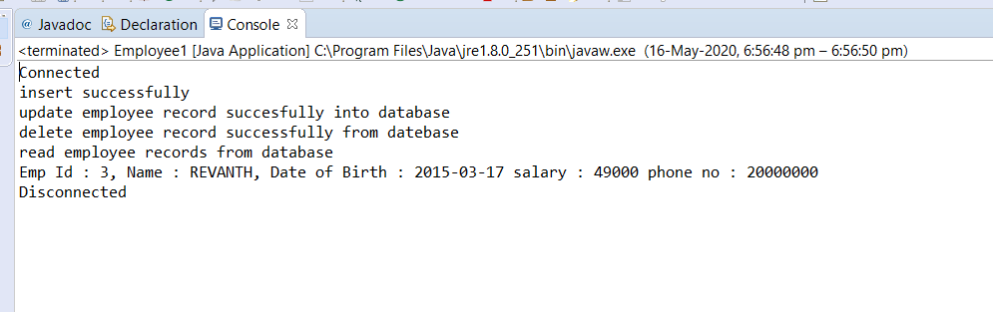
Output 1 :

Slide 24
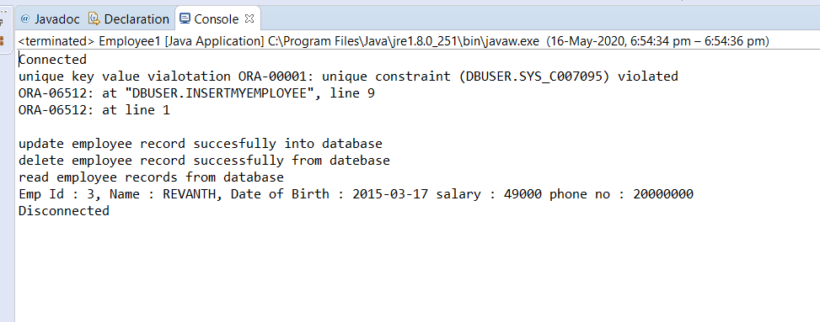
Output 2 :

Slide 25




our team
Hanisha
Keerthi
Prasanna
Prasuna

Slide 26
THANK YOU

